Slide 1
Overview of CTD Data from NABOS 2023
Unless otherwise noted, the profiles shown use data that are binned to 1 m in post-processing.

Slide 2
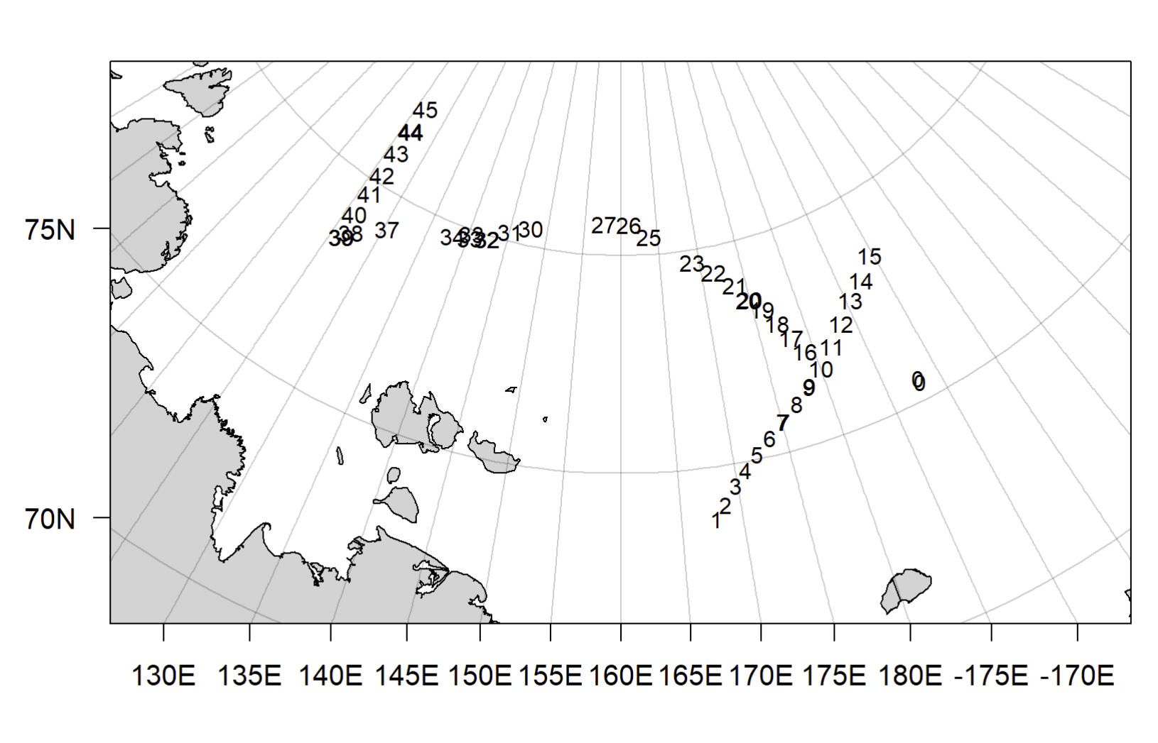
Map overview with station numbers for reference

Slide 3
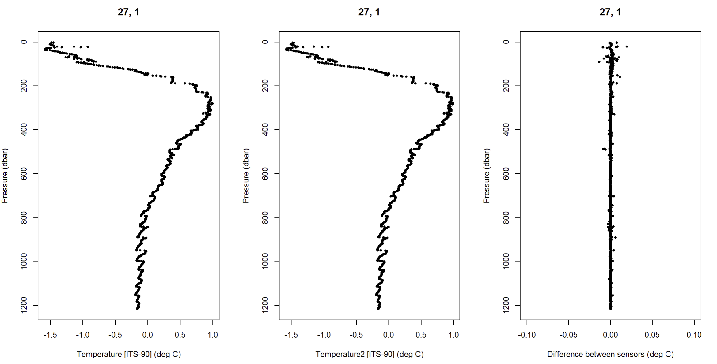
First signs of confusion:
Seeing large variability in temperature at depths below 500 m. Consistent in primary and secondary temperature (left and middle plot respectively). This is just an example profile (Station 27), but the feature shows up in many profiles (see pdf attachment in email for profiles of each station/cast)

Slide 4
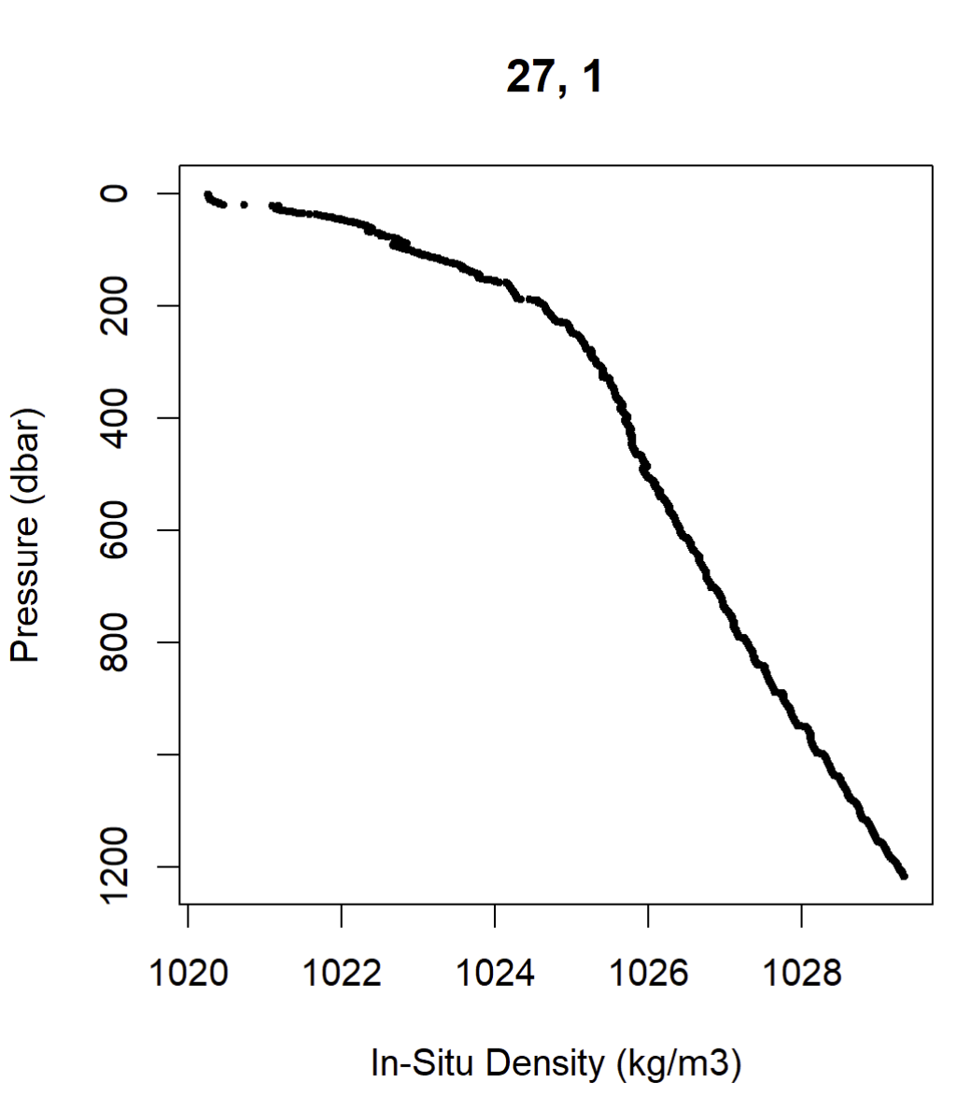
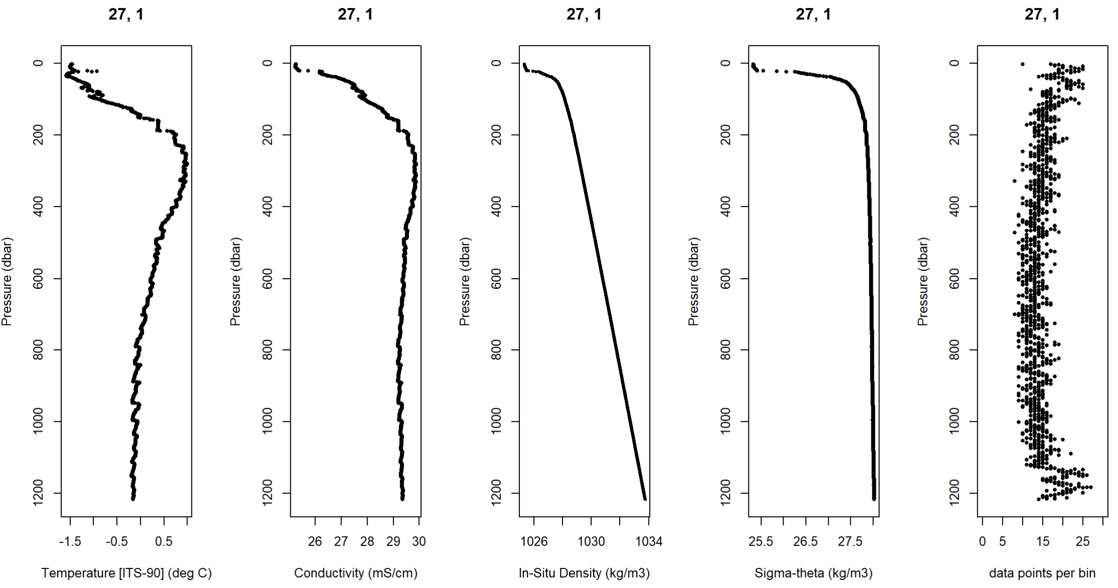
First signs of confusion:
Plotting other CTD and CTD-derived parameters as validation, Station No. 27. In-situ density shows some inversions at each of these “steps” in the Temperature and CTD data. Next couple slides are other example stations
Zoom in on in-situ density

Slide 5
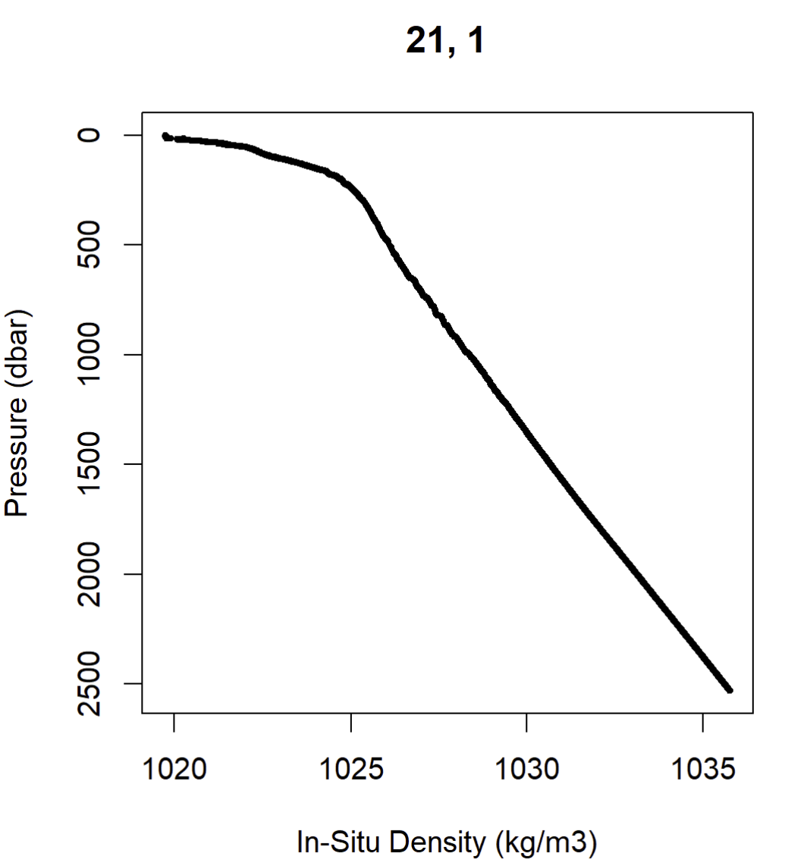
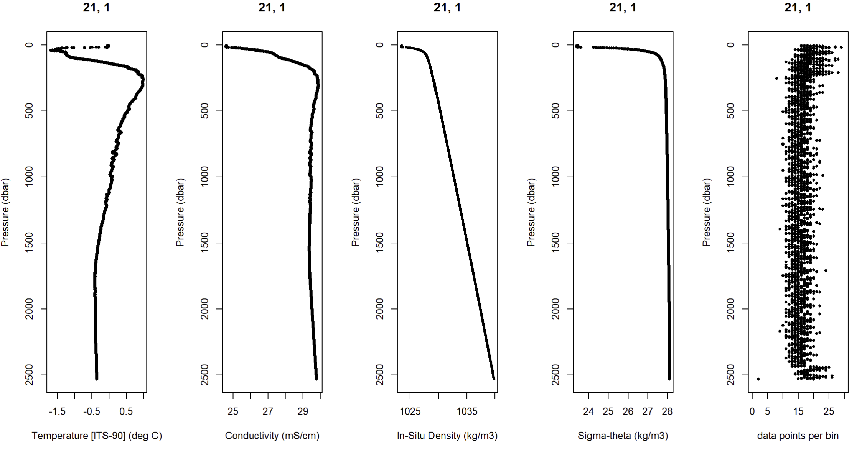
Example Station 21

Slide 6
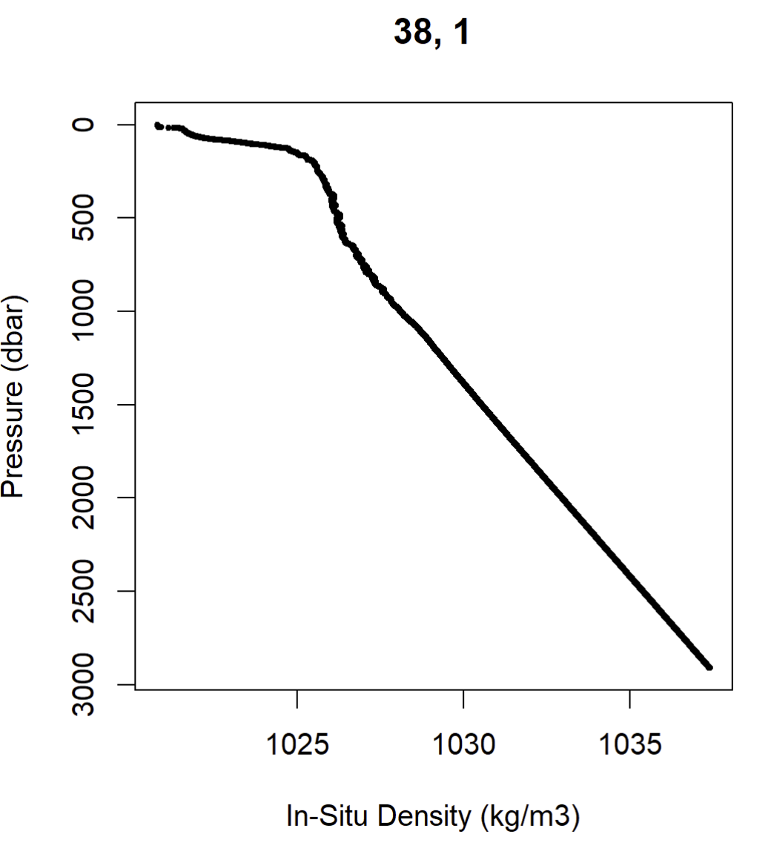
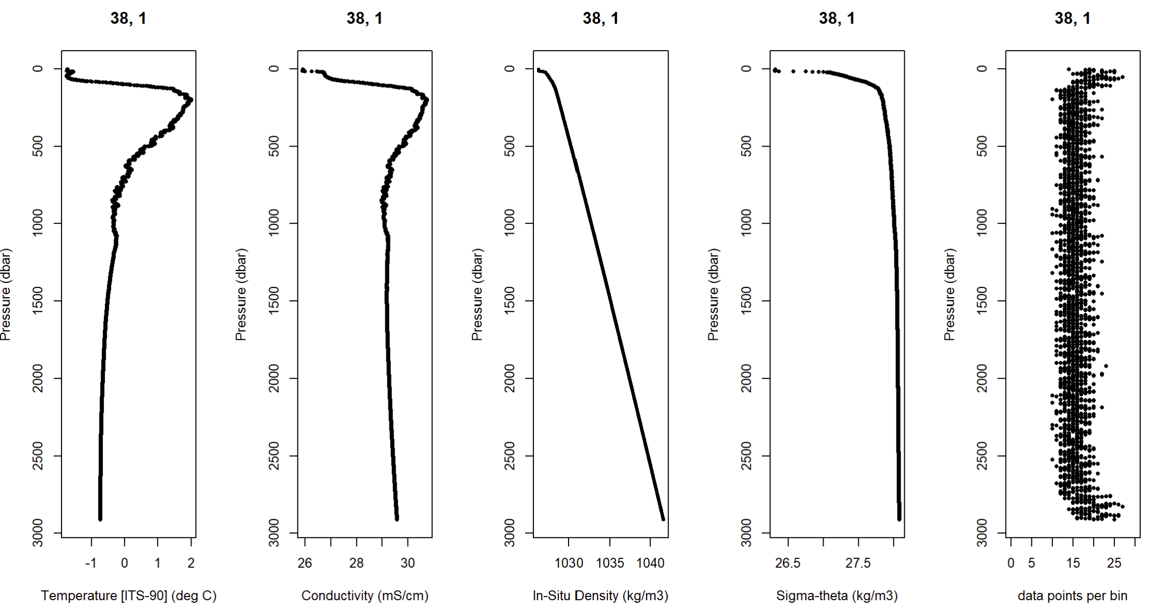
Example Station 38 (~10 nm from M1)

Slide 7
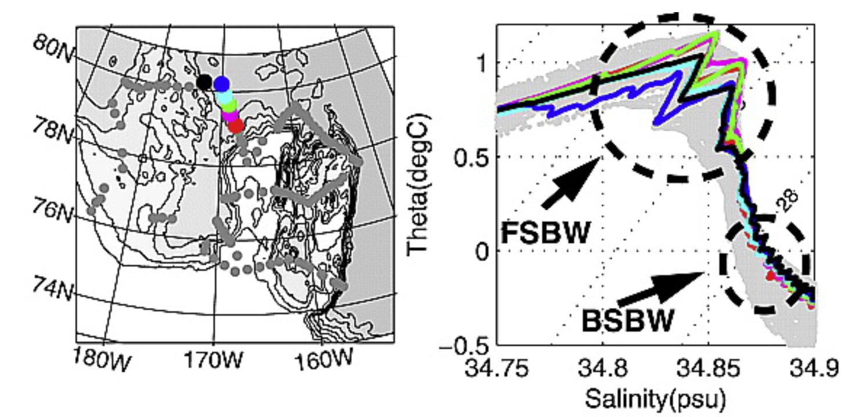
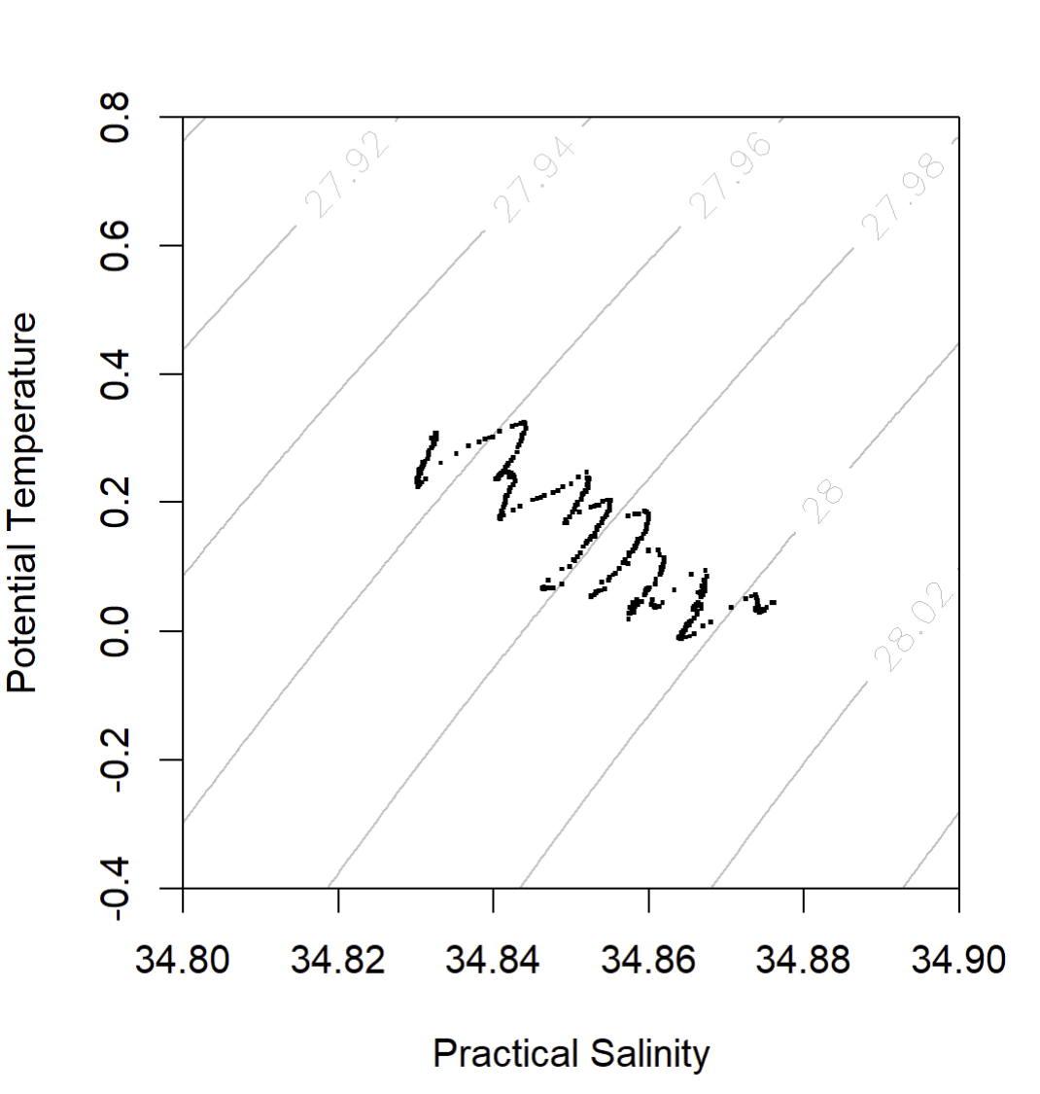
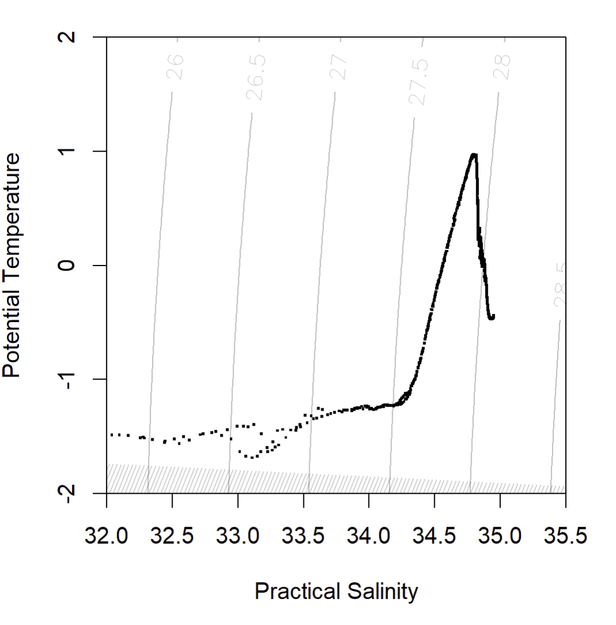
Let’s look at TS plots & sigma theta space…
Woodgate et al., 2025
T-S plots have “zig-zags” where this feature is. Looks similar to Woodgate et al. 2025. A bit odd that so many of the “steps” are isopycnal. Station 21.
Full profile
600 -1000 m depth

Slide 8
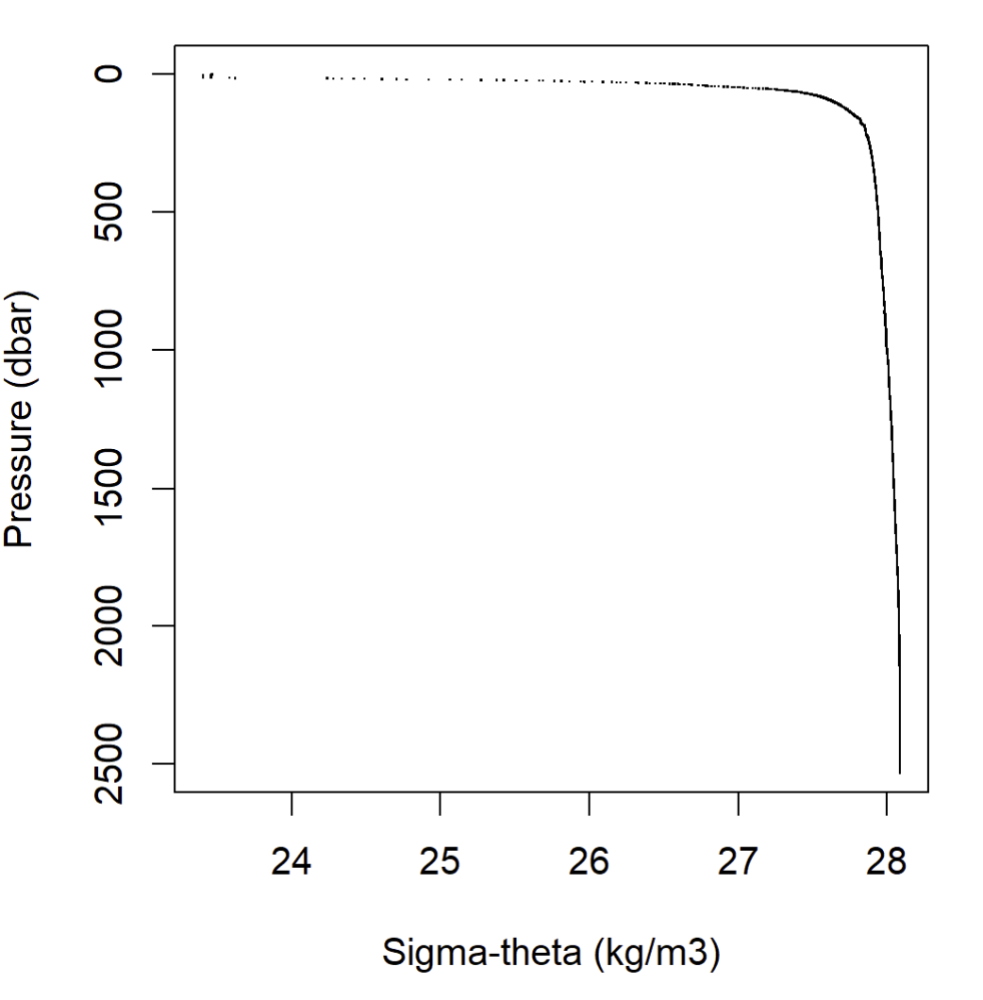
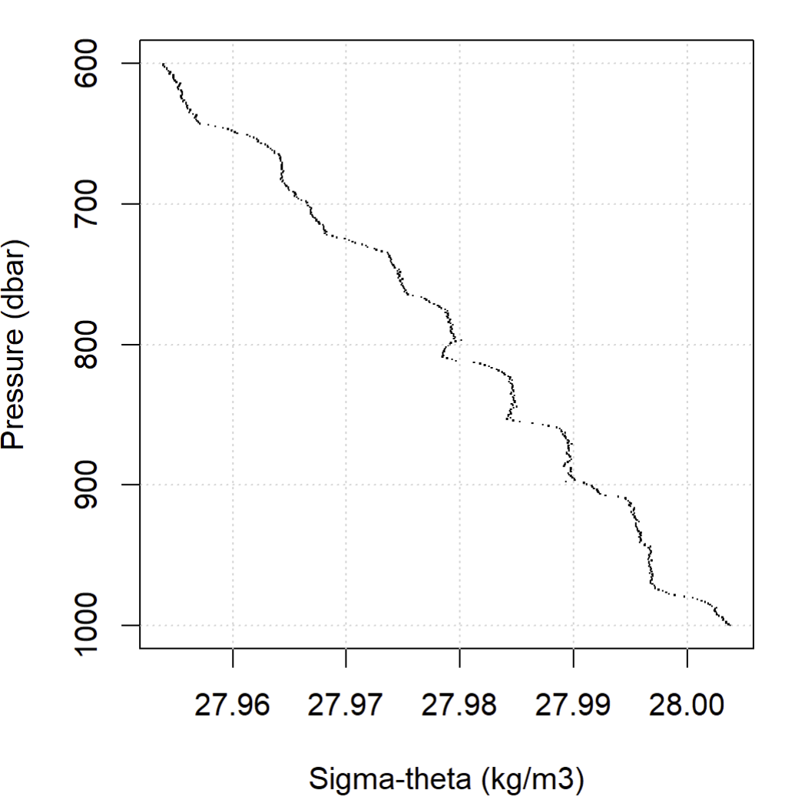
Let’s look at TS plots & sigma theta space…
More on sigma-theta, shows that some of these steps are predominantly along isopycnals. Station 21.
Full profile
600 -1000 m depth

Slide 9
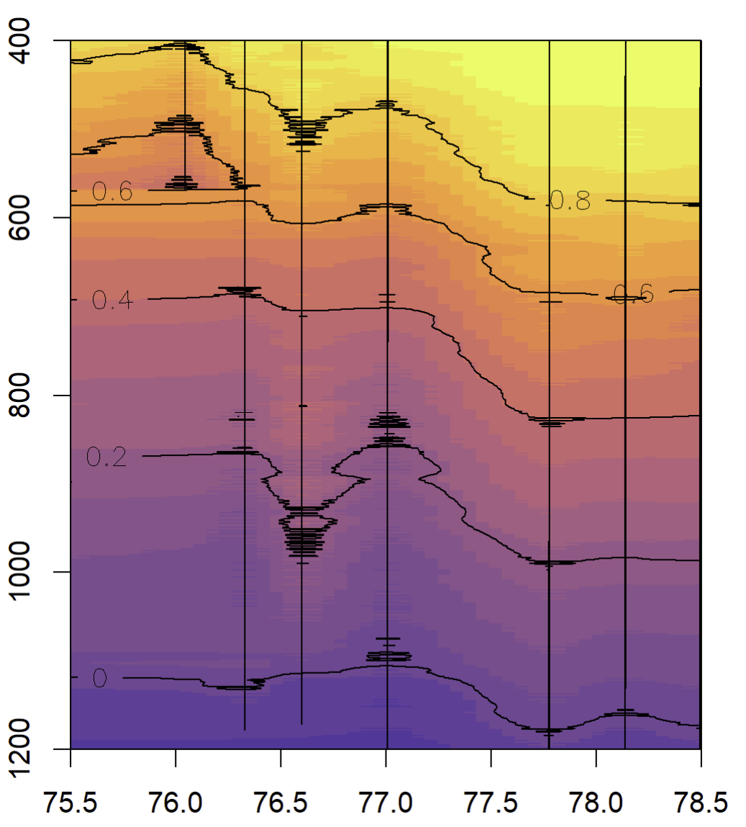
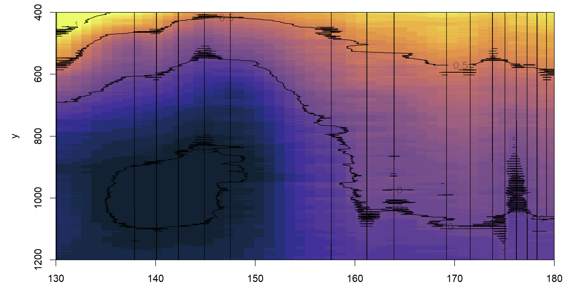
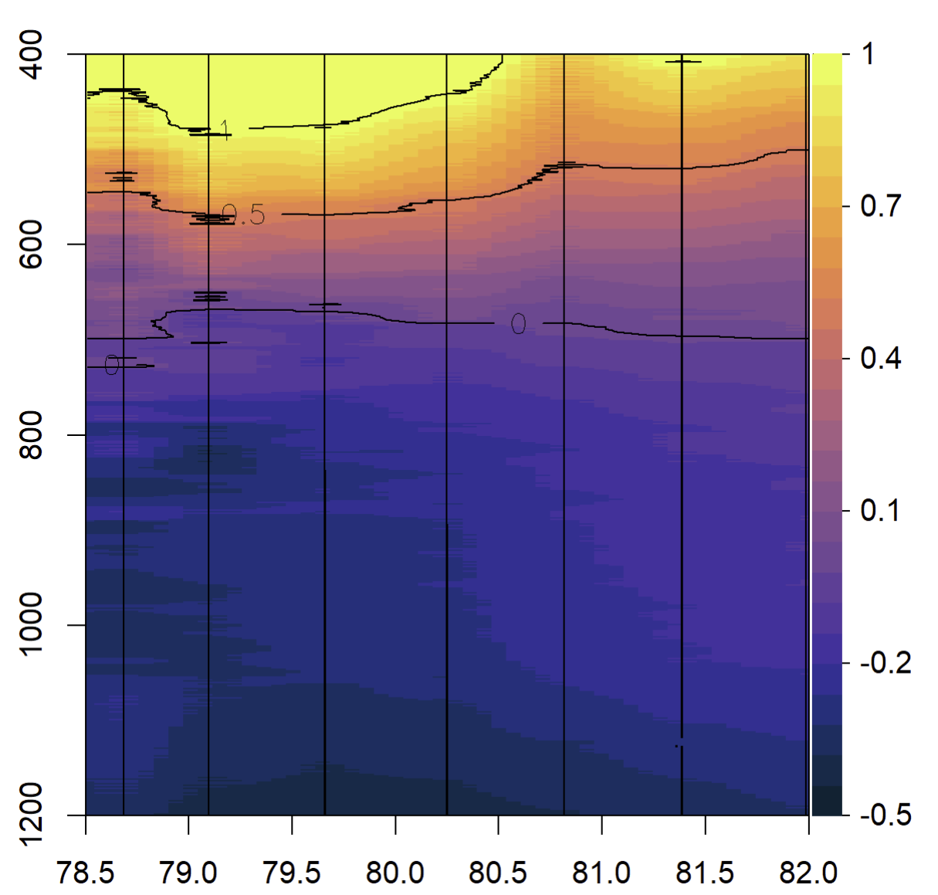
Where is this happening geographically?
This downcast data is gridded for plotting with temperature contours overlain. The contours really reveal stations that are having a lot of the “zig-zag” feature. It doesn’t seem consistent with a specific geographic region (e.g., Makarov, Amundsen, or ridges…).
East Siberian Sea transect (400 – 1200 m)
Along Slope transect (400 – 1200 m)
Amundsen transect (400 – 1200 m)
Temperature (C)
Latitude
Longitude
Latitude

Slide 10
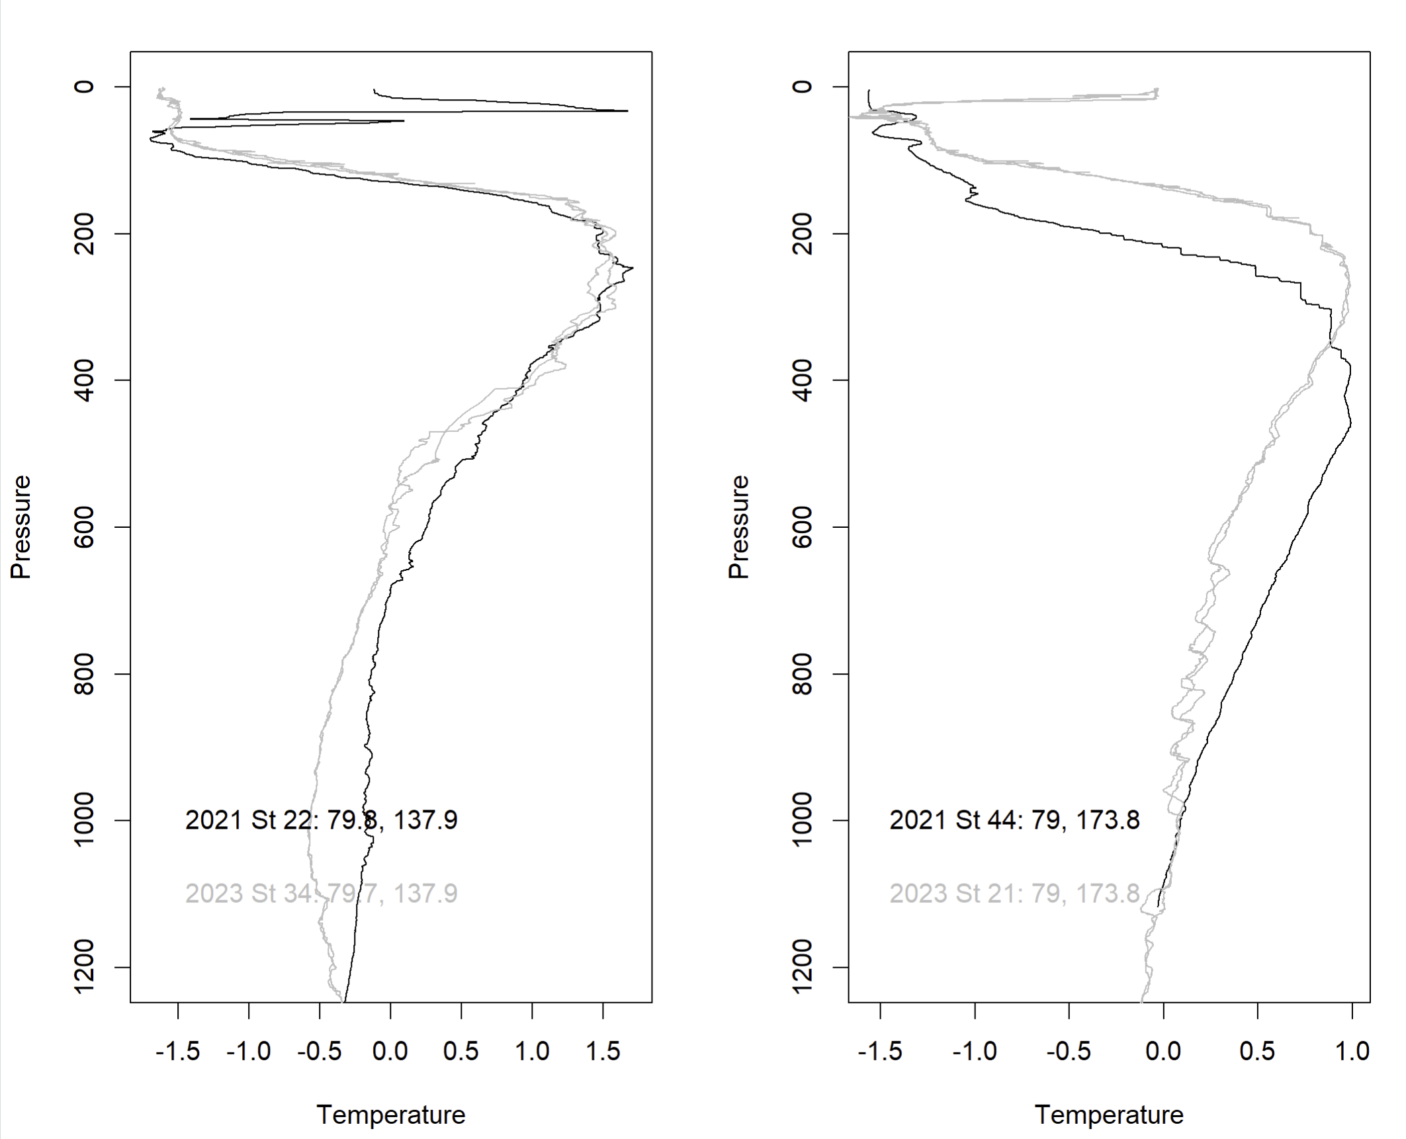
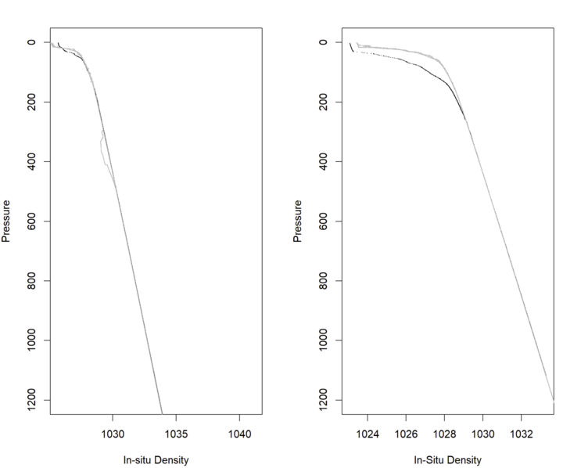
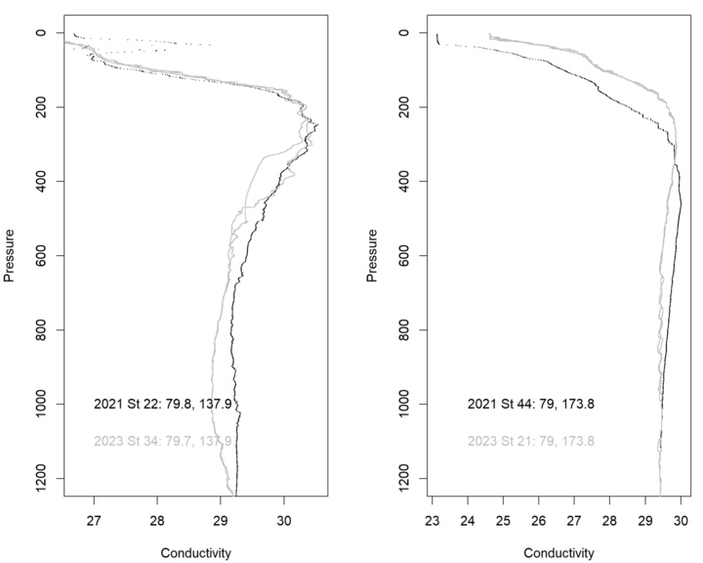
How does it compare to 2021 where we have overlapping stations?
This was a quick comparison I made pulling cnv files from 2021 and 2023. 2021 was only the downcast and binned, 2023 I was interested to see both down and upcasts (feature exists in both directions), so it’s at the stage in processing before binning. I’ve pulled two stations for a quick comparison: one station that doesn’t really have a strong zig-zag feature and one station that does.

Slide 11
Summary of thoughts
Primary and secondary sensors are affected but are plumbed on separately.
When there is a “squiggle” feature, it occurs in both downcast and upcast data. (not validated for all stations, but spot-checked)
No significant difference between raw scans and binned profiles.
Pressure sensor increases with time (likely not a pressure sensor issue)
Preliminary geographic assessment doesn’t reveal consistency with location/regions.
Squiggles are frequently aligned with isopycnals: why are these features isopycnal but not homogenous ("stratified" with spice)

